Slide 1
Does Heart Surgeries Mortality Rate Increase in VA hospital?
The change of heart surgeries Mortality Rate from 1980-1982
---Wenru Zhou

Slide 2
Data and plan
Procedure | N (Percent)
Valve surgery | 5053 (19%)
CABG surgery | 20899 (81%)
Other surgery | 2 (0%)
Patient’s condition
1 | 12 (0%)
2 | 1148 (4%)
3 | 7986 (31%)
4 | 15277 (59%)
5 | 1401 (5%)
Weight,lb | 165.96±36.12
Height, inches | 65.33±2.62
BMI, kg/cm2 | 28.23±4.03
Albumin, g/dL | 4.04±0.58
30 days morality | 718 (3%)
Data summary:
Total number of hospitals: 44. Total time: 3 years (6 month as unit)
Outcome: 30 day mortality per 1,000 heart surgeries
Fixed effects: Years, procedures, patient’s condition
at the start of surgery, height, weight, BMI, albumin
Random effect: hospital,
we have the reason but will ask the investigator to make sure
Goal: whether certain VA hospitals have too high (or low) of a death rate
from heart surgeries compared to a hospital level risk adjusted estimate of death risk
Steps:
Check missing and impossible values
Identify missing patterns
Visualize deaths rate, expected death rate, trends
Fit a GLMM model with logit link to find out
if there is a significant change of odds of mortality in the past 6 month

Slide 3
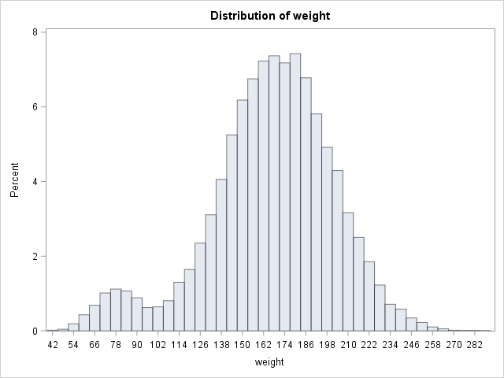
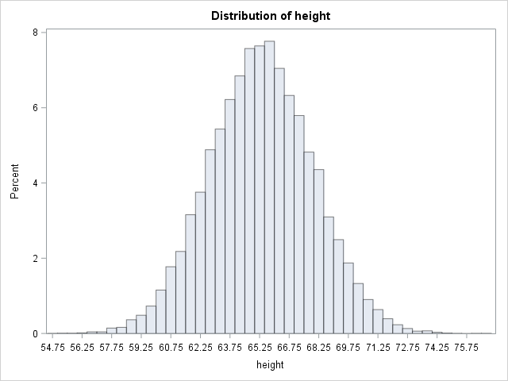
Missing values and patterns
3 BMI outlier
Procedure=2, plan to delete
Missing table
BMI ERROR at 1982JUL-DEC, :
For hospital 1-15, all of the BMI are incorrect
For Hospital 18, 20, 23, 1 BMI is incorrect per hospital, the percents are 1.15%, 1.08% and 0.88%
We tested the missing status of each variables verses
Other variables
Missing status of other variables
Manipulation of other variables (the cut point of mixture distribution of weight and the normal range of albumin)
Method: t-test, Wilcoxon-Mann-Whitney, chi-sq test and fisher
Variable | Missing (total=26491)
Procedure | 2.03%
Patient’s condition | 2.52%
Weight,lb | 2.51%
Height, inches | 2.51
BMI, kg/cm ^2 | 2.51%
Albumin | 49.92%
The distribution of albumin, height and BMI are fairly normal, while weight is not
The missing pattern of weight, height and BMI are MAR, related to each other
Cutpoint=102

Slide 4
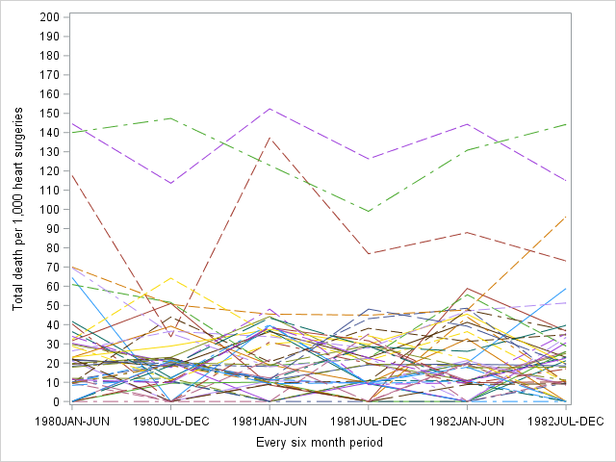
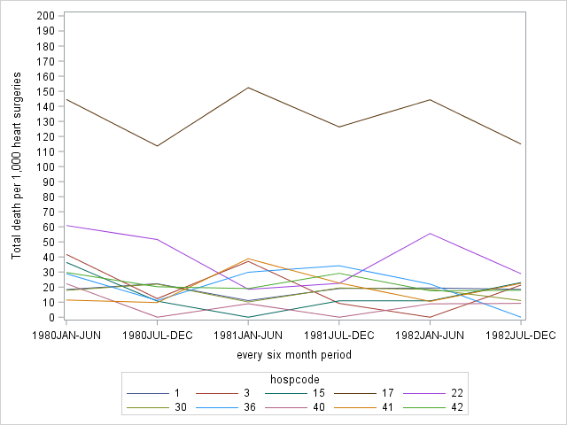
Data trends
Total 44 hospitals
Randomly selected 10 hospitals
Find out the change of mortality rate in the past 3 years using mixed model
Find out if there is a significant change of mortality rate in the past 6 month
$$\log\left(\frac{Mortality rate}{1−Mortality rate}\right)=β_{0}+β_{1}\text{Years}\text{+}β_{2}\text{procedures}\text{+}β_{3}\text{patient}\text{’}\text{s} \text{condition} \text{at} \text{the} \text{start} \text{of} \text{surgery}\text{+}β_{4}\text{height}\text{+}β_{5}\text{weight}\text{+}β_{6}\text{BMI}\text{+}β_{7}\text{albumin}\text{+}b_{0}hospital$$

Slide 5
Delete procedure=2 and missing
ASA:Categorical or not?
Check: periods#39, ASA distribution: most of them are in3,4 (88%)
Albumin: missing a lot, delete
BMI and weight height are highly correlated, we can only keep BMI.
Compare 34-38 and 39, two period
Each hospital, plug the past model predictor, then analysis the #39
Predicted death rate, expected death rate, plug in the regression model. Predict is different than expect.

Slide 6
Analysis plan
Calculated the death rate for each hospital over 3 years
Ignore hospital, fit a simple logistic regression using past 2.5 years

